Slide 1
Radio Demonstrations
Cyber Security of Wireless and Distributed Systems

Slide 2
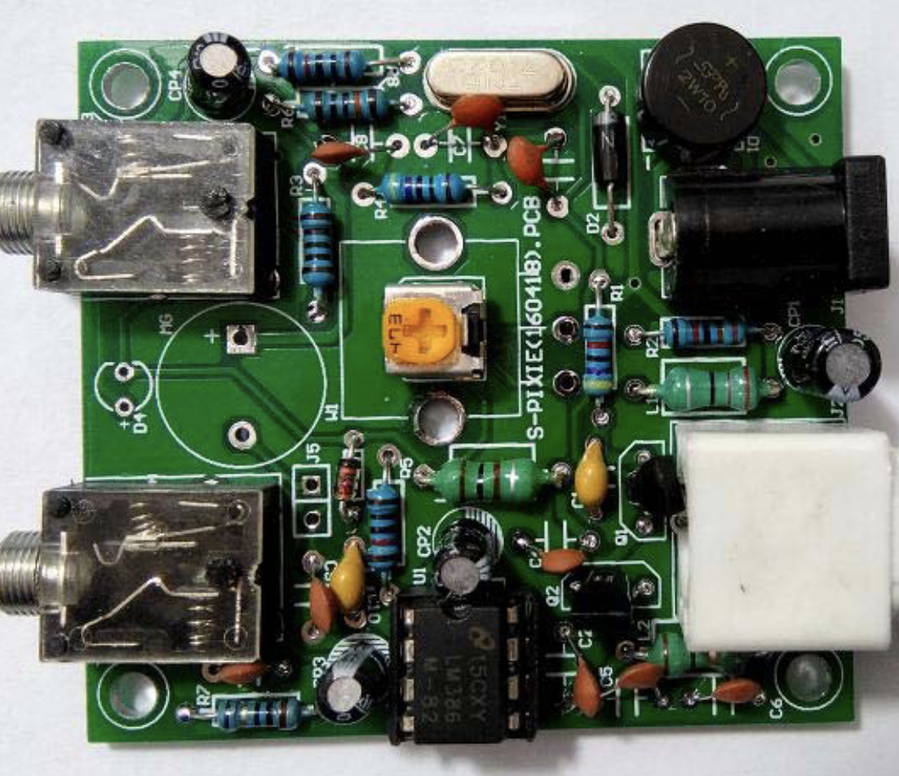
40m CW QRP Pixie
About $20 of parts in kit form
Verify parts are correct (I was missing a diode)
Solder parts to board
Make or buy CW key
Make or buy antenna
Test!

Slide 3
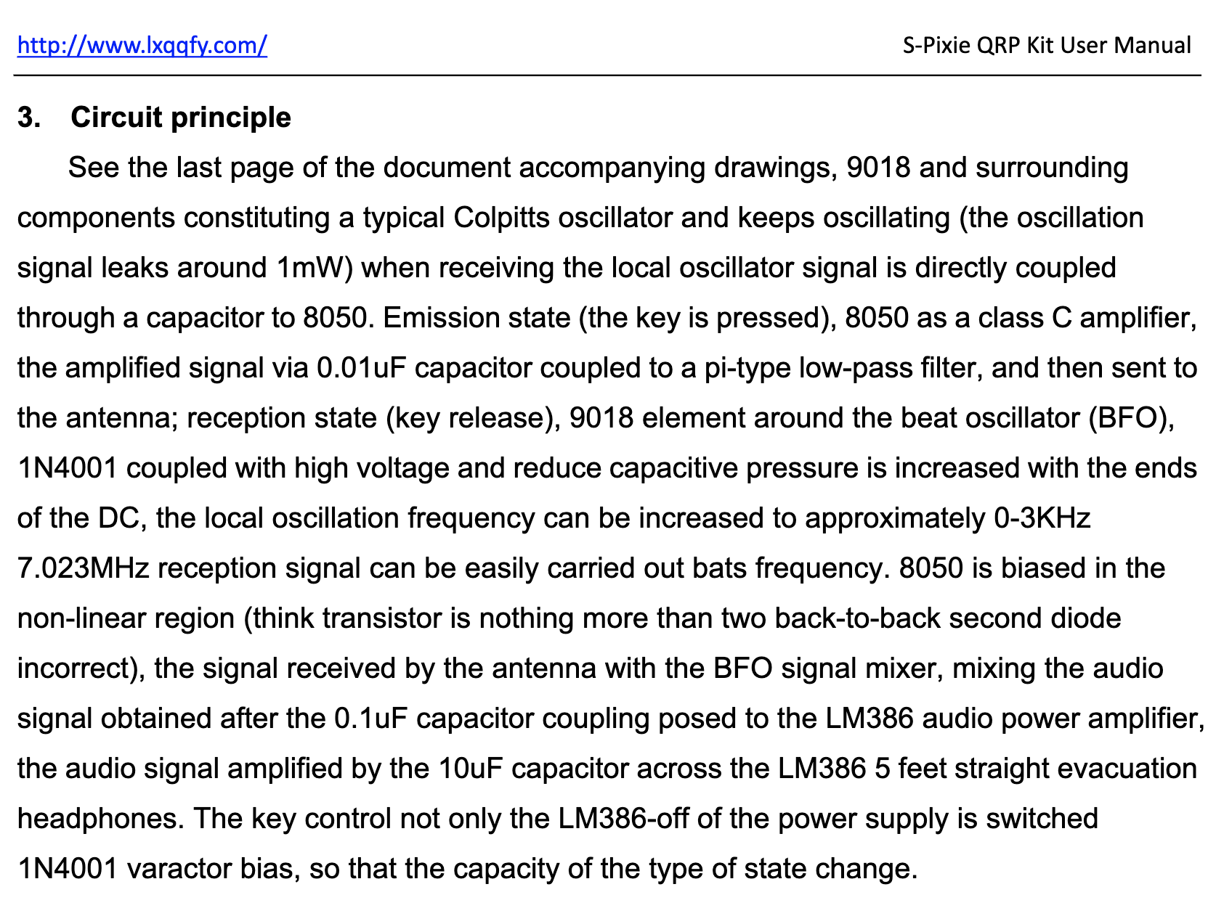
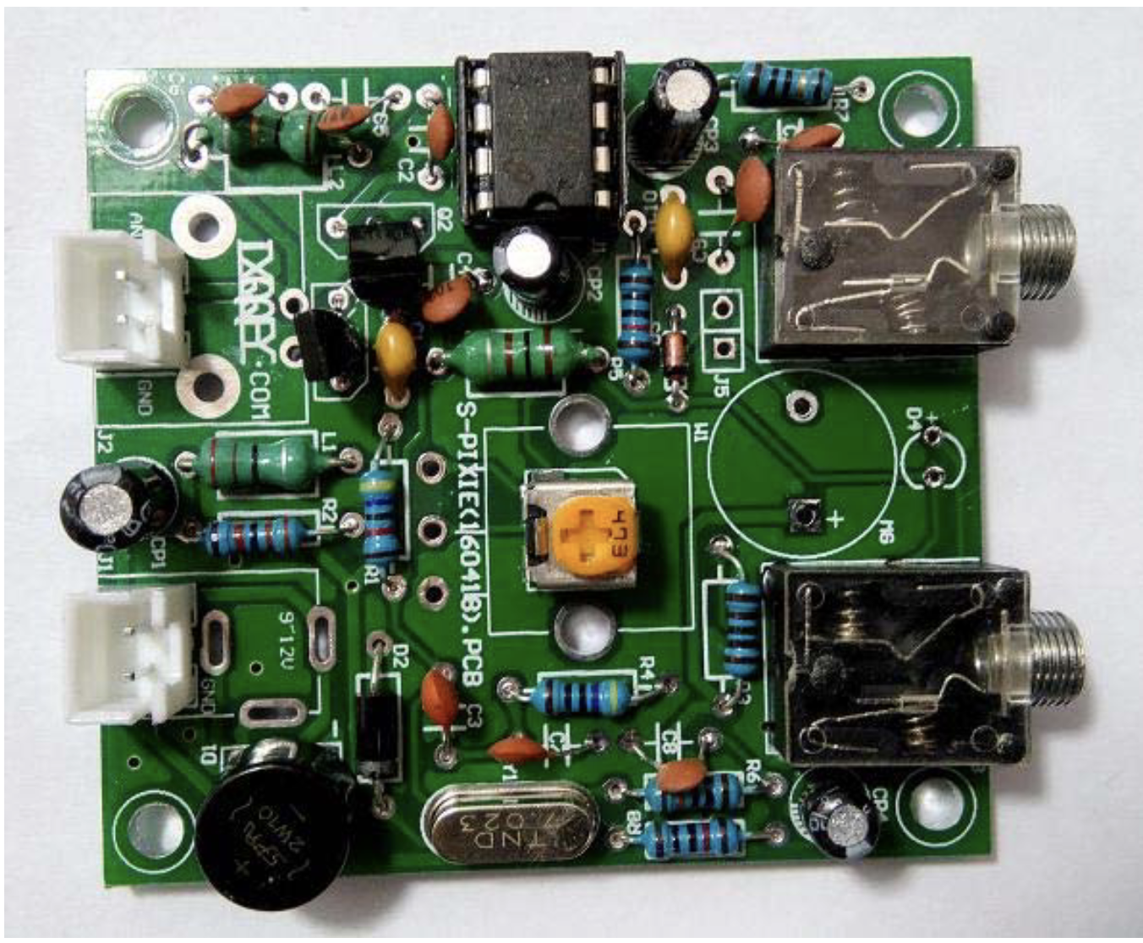
Circuit Principles

Slide 4
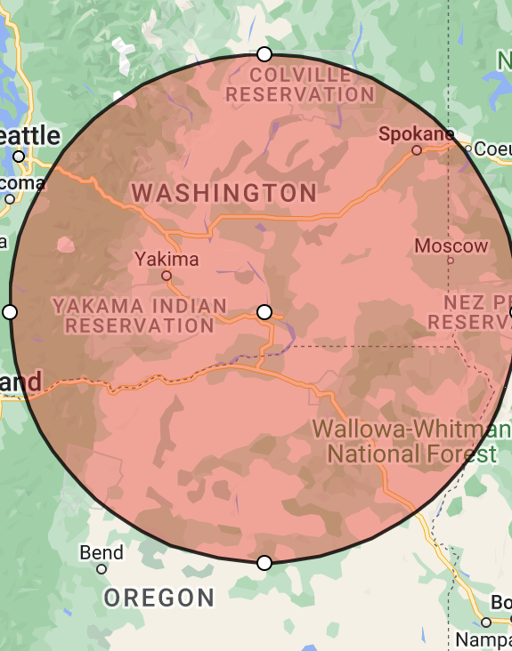
Fun radio to take hiking!
Approximate transmit / receive distance of 300 miles on a 9v battery!
Lightweight
Practice Morse code
POTA / SOTA activations
Notes:
Antenna is also made from a kit. It is a ½ wave, end-fed wire tuned to 7 kHz frequency.

Slide 5
Omnidirectional antenna sensitivity demonstration
Notes:
Tune to WX radio station. Hopefully, you can receive it indoors! (I can at home!)
Omnidirectional antennas transmit and receive signals from all directions.
But they can still be used for crude DF by tilting and rotating the antenna to determine the general direction of the transmitter—assuming some things about the wave propagation! (shortest path, no bounce, no repeater, etc.)

Slide 6
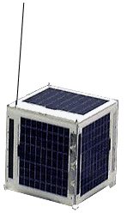
Directional antenna demonstration
AMSAT SO-50 (Saudi Sat)
VHF uplink (145.850 MHz)
67.0 Hz PL tone access
UHF downlink (436.795 MHz)
10-minute timer must be armed
74.4 Hz PL tone for 2 seconds
Usually already armed by someone else
¼ wave antennas
Notes:
VHF (longer shorting bar)
UHF (shorter shorting bar)
Must account for Doppler effect by tuning slightly higher on the UHF frequency (doesn’t matter if it’s uplink or downlink, as shorter wavelength is more greatly affected.)
Drop to normal tuning as satellite is overhead,
Tune slightly down as satellite movies away from you.

Slide 7
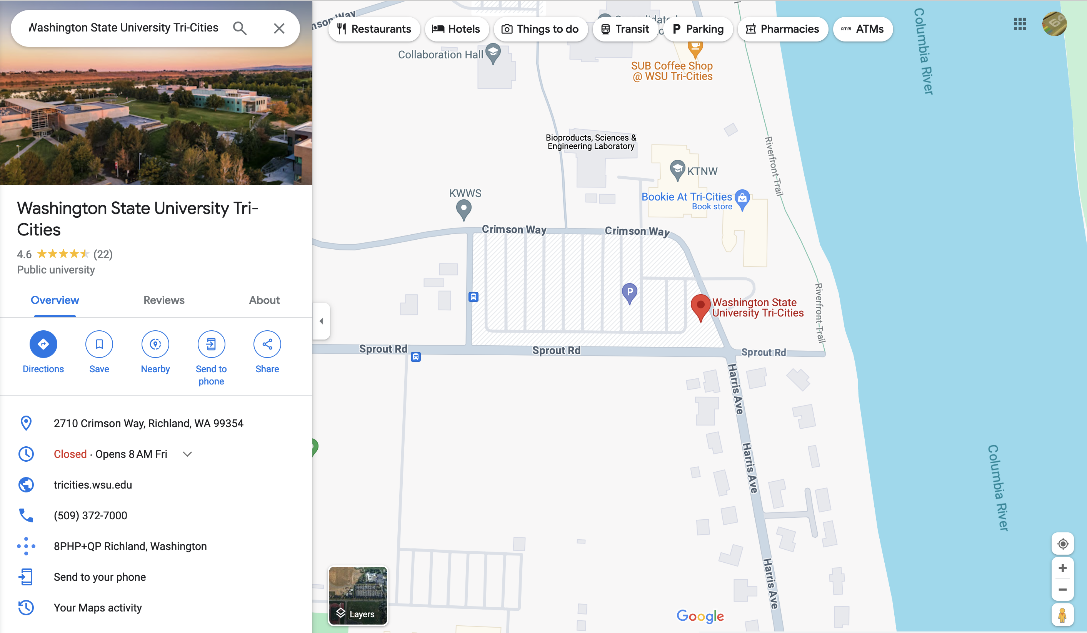
Satellite pass prediction #1 Local coordinates

Slide 8
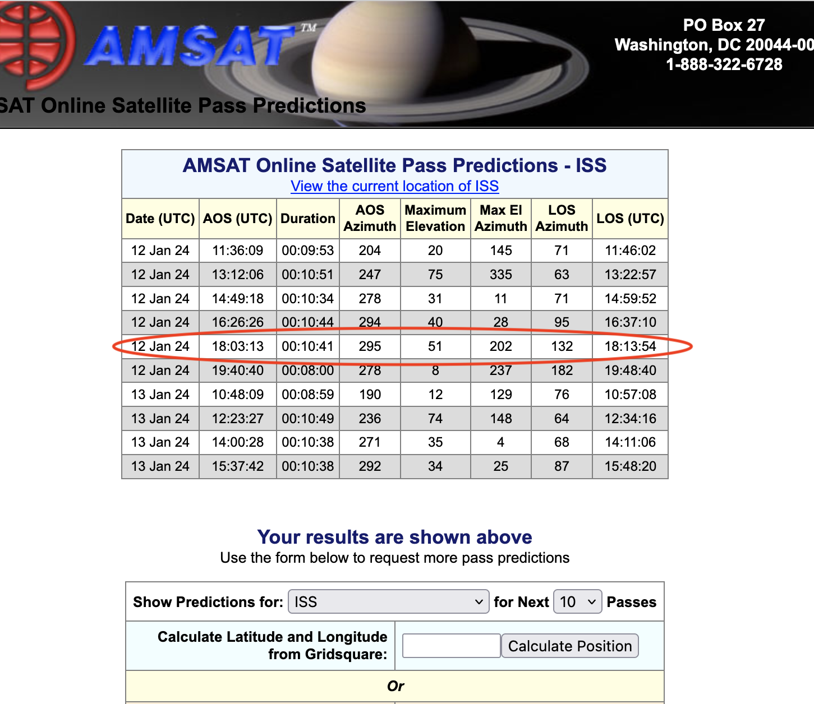
Satellite Pass Prediction #2 AMSAT.org
Notes:
UTC time is 8 hours in the future from PST!
ISS was over WSU about 5 minutes before class! Good elevation too (at least 45 degrees)

Slide 9
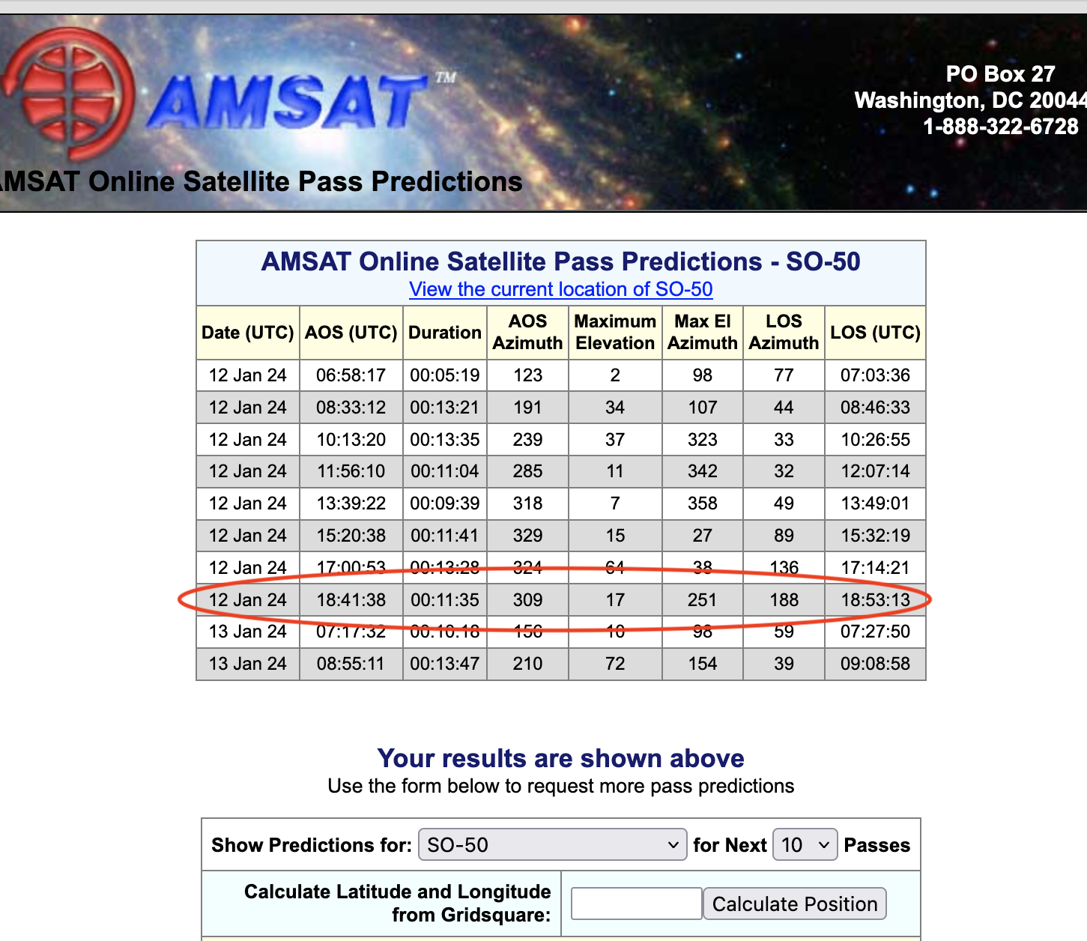
SO-50

Slide 10
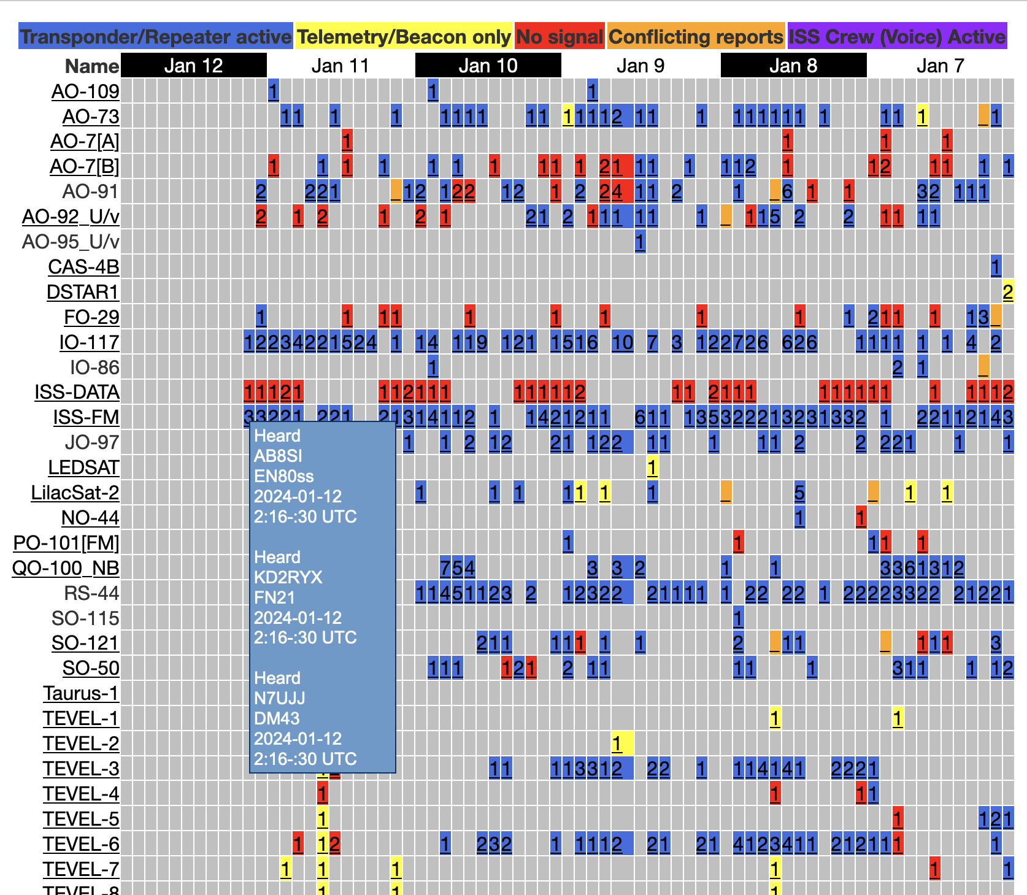
Current Satellite Status

